Slide 1
Gene expression analysis for low MIC high Pearson (top4 difference)

Slide 2
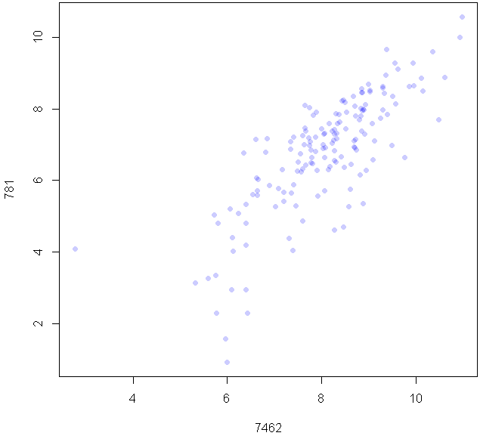

Slide 3
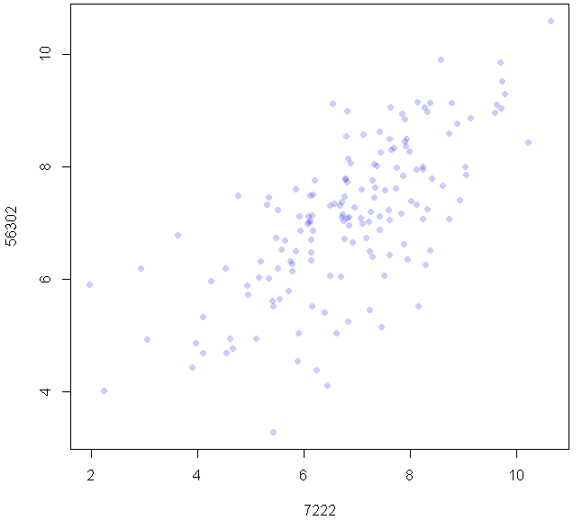

Slide 4
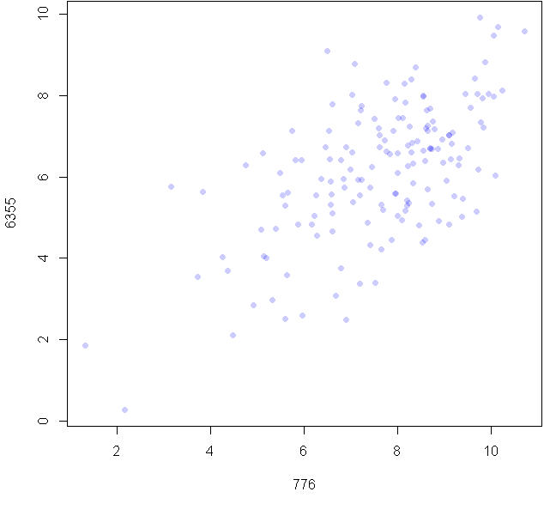

Slide 5
